Slide 1
ChatGPT vs. Edward SAID
Generative AI in Underresourced Domains and Languages
Georgetown University, May 2025
Presented by:
Irene K. F. Kirchner
Digital Humanities Specialist, Program of Islamic Law,
Harvard Law School
Ph.D. Candidate, Department of Arabic and Islamic Studies,
Georgetown University

Slide 2
Outline
What work: Applications of Generative AI in academic research
When it doesn’t work: Challenges of Generative AI for underresourced domains
How does it work: Technical introduction to Generative AI
What to ask to make it work: Prompting strategies for navigating Generative AI
Y’all work for me: Miss Informed vs. Edward SAID
Who works better: Jonathan Brown and the future of (my) Ph.D. advisors
Work on it yourself! Practical exercise
What worked for you? Questions & Answers & Discussions
Notes:
So, let’s start. I don’t think I have to introduce myself which is good because we can dive right in.
That being said, I wanna make a few disclaimers:
Everything that I will be showing you relies on working with the latest version of ChatGPT or Claude, so that’s GPT4 and Claude 3 and some others, but the thing is that they are all behind a pay-wall and you need to pay 20 bucks a month for a subscription in order to access it. Many things I will be showing you, won’t work for the free versions, but many do, so you’ll just have to try and see. I want you to work out of here today with a sense for what is possible, what you gotta look out for, and some strategies to navigate LLMs and Generative AI.
I also will only talk about Generative AI and textual data, although many models such as ChatGPT can also work with images, code etc.
That being said, nobody really knows how AI works, what it can or cannot do. We’ll only find out through engaging which is why it is especially important that we do.
What I will show you today also does not portray “how I work with it” or “what works for our field”. Instead, I am only sharing with you the ways that I am experimenting with this tool and what I am observing.

Slide 3
Applications of Generative AI in academic research
Survey:
Who has worked with ChatGPT or another Large Language Model before?
How did you use it and did it deliver?
Notes:
Who has actually worked with ChatGPT or another LLM or Generative AI before? And what did you ask it to do?
Here are some tasks for which I have tested different models more or less successfully (focus on ChatGPT-4):

Slide 4
Applications of Generative AI in academic research
Brainstorming
Prompt: I am giving a workshop on Generative AI for underresourced domains and languages. I want everyone to learn about the most important challenges of working with Generative AI in fields like Islamic Studies or with medieval literature in Classical Arabic and strategies to address these challenges. Brainstorm out loud what points I should cover in a 60 minute presentation. Be comprehensive and detailed.
Response: https://chat.openai.com/share/9c9fcd60-e8ab-435a-a634-412693676c08
→ Generic: that can be good
→ Use for overview, starting point
Notes:
Problem: for underresourced knowledge domains, it may give too generic or biased overviews.

Slide 5
Applications of Generative AI in academic research
Understanding (technical terms, but also error code et al.):
Prompt: Analyze Kant's concept of 'das Erhabene' ('the sublime') and its significance within his philosophical thought. Define 'das Erhabene' as Kant uses the term, explain how he distinguishes it from related concepts like beauty. Also situate the sublime within the broader context of Kant's aesthetics and explain how it relates to key ideas from his moral philosophy and epistemology.
Response: https://chat.openai.com/share/18adf53a-9562-4526-a48d-f61678f19183
→ Similar to brainstorming and more like a starting point, but the more detailed the question, the more specific the answer.
Notes:
Problem: for underresourced knowledge domains, it may not always give you any or correct answers.

Slide 6
Applications of Generative AI in academic research
Reading
Use for: Summarize publications, ask for quotes (will hallucinate), but also find specific info:
Upload the Arabic version of Ibn al-Jawzi’s Kitab al-Mawdu’at as .txt file (OpenITI)
Prompt: “Is there a hadith on insects in this document?”
Response: https://chat.openai.com/share/f47bd1f4-b4b0-494d-ab0d-f85276643fc8
Notes:
Problems: It will keep finding insects as long as you’ll ask.
Means: You really gotta know your stuff! Verification can be difficult and labor-intensive.

Slide 7
Applications of Generative AI in academic research
Translation
Prompt: Translate this legal phrase: كلّ تدليس يختلف الثّمن لأجله يُثْبِت الخيار
Response: https://chat.openai.com/share/c0ab0db4-50a8-4f21-b65c-375e17a74eb0
→ English better than Arabic
→ shorter better than longer
→ .txt or .doc files better than .pdf
→ Give context (e.g. legal) to get domain specific results

Slide 8
Applications of Generative AI in academic research
Writing or Editing?
Prompt: Complete this sentence on Laclau’s theory of hegemony, the constitutive role of social heterogeneity and his rejection of essentialism and explain it: "Fully formed, positive elements with inherent identities that are not defined in relation to each would be reducible to a deeper homogeneity because...
Response: https://chat.openai.com/share/1767e335-87ec-4a8c-9170-5f712623fcce
→ Content correct, terminology mixed (pre-discursive is good, “fluid” is not)

Slide 9
Applications of Generative AI in academic research
Advising/engage
Prompts: You are Jonathan A. I. Brown, an expert on Islamic history and Hadith and my academic advisor. This is an outline of my arguments, building on these sources, proposing this conclusion. First, read Jonathan A. I. Brown’s Canonization of Bukhari and Muslim. Then review my arguments and engage in a critical discussion with me, probing and challenging my argumentation, and proposing alternative arguments or conclusions.
Response: Somewhat along the lines: Good analysis of “repeating what I said”, you clearly demonstrate XYZ, but brainstorm what this would look like in a different context (contemporary, Shi’i, etc.)
→ Experiment in progress
Notes:
Give anecdotal examples from working with Jonathan A. I. Brown:
Asking for feedback
Asking for knowledge
Asking for dialogue
Things to consider: Availability, creativity, originality, contextualization and relevance (in arguments but also in analogies: jokes and pop cultural references)

Slide 10
Applications of Generative AI in academic research
Information Retrieval
Prompt: In this document, find the first and the last transmitter for the isnad of Hadith number 1237 (or the Hadith on the creation of bees.
→ Experiment in progress.
Notes:
Information retrieval vs. information generation: What works and what doesn’t?

Slide 11
2. Challenges of Generative AI in underresourced domains
Survey:
Have you come across any challenges like hallucinations?
Anything that you think may be specific to Islamic Studies, or Arabic?
Notes:
Hallucinations: What are they and why are they particularly problematic for underresourced knowledge domains?

Slide 12
2. Challenges of Generative AI in underresourced domains
Hallucinations & Misinformation
Prompt: Provide 3 quotes from Jonathan Brown's Canonization of Bukhari and Muslim that provides evidence for the argument that the Sunni tradition was motivated by clear distinctions between social classes and a theological privileging of wealth over knowledge.
Response: https://chat.openai.com/share/2cc954b1-7a7f-4201-9f55-65fa147e76ed
→ Verifification is not so easy!
Notes:
Hallucinations happen more often in underresourced domains. Popular misinformation will be amplified. Input will frequently be verified.
Not so easy. Page numbers not correct. But maybe somewhere else in this book? Other works by Brown? Other works by others? Correct summary or just total bs?

Slide 13
2. Challenges of Generative AI in underresourced domains
Cultural Sensitivity and biases
Prompt: Let’s write a story about a woman at the end of her 20s who is pursuing a career in theoretical physics and her journey and experiences in academia. Please flesh out this character, brainstorm names, appearance, and a backstory to make her more relatable.
Response: https://chat.openai.com/share/a5fc6426-8afd-494a-bdfd-0a5994f805ee
→ Often Asian, though one Hispanic sounding name suggestion.

Slide 14
2. Challenges of Generative AI in underresourced domains
Response denial
Nope.
Accessibility
Subscription cost, credit card payment and foreign transaction fees, internet, etc.
Societal Impact
Restricts social and economic participation and equal opportunity, restricts ability to communicate, amplifies misinformation and biases, restricts critical review by exactly those impacted negatively, with consequences for all sectors, education, politics, marketing, health care, insurance etc.

Slide 15

3. Technical introduction to Generative AI
Training data
→ whatever is digitally available
Notes:
What are Large Language Model or Generative AI and how does this actually work?
The journey of training a language model begins with the training data and as the name Large Language Model indicates, this training data consists of massive amounts of textual data - imagine hundreds of billions of words scraped from websites, books, articles on the internet and and from whatever they could get their hands on on the internet.

Slide 16
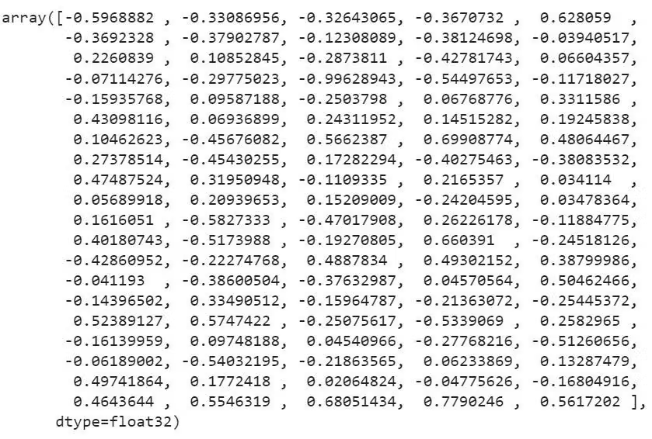
3. Technical introduction to Generative AI
Tokenization and Initialization
Notes:
Tokenization and initialization:
Let’s simplify things and say the next step is tokenization - so the process of breaking down the raw text data into individual words or subword units. Each unique token in the model's vocabulary is then assigned a high-dimensional vector representation. You can think of these vectors as lists of numbers, often with hundreds or even thousands of components, that allow the model to capture nuanced relationships between words. Initially, each token is randomly assigned a unique vectors.

Slide 17
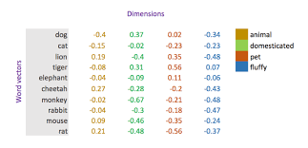
3. Technical introduction to Generative AI
Training
Notes:
Training Process: With the data tokenized and vectorized, the actual training can begin. The model processes the training data, one token at a time, and updates the vector for each token based on the context in which it appears. With each update, vectors of tokens that appear in similar contexts are made more similar to each other. Let's consider a concrete example. Suppose training data feeds the model the sentence "The cat sat on the mat". It would learn that the vectors for "cat" and "mat" should be more similar to each other than the vectors for "cat" and "democracy" or “asteroid”, because "cat" and "mat" appear in closer proximity more often. Over the course of training on millions of such examples, the word vectors are gradually adjusted to encode the semantic relationships present in the training data.
Semantic Information in Vector Space:
One of the actually brilliant aspects of this approach is that the resulting vector space geometry captures a wealth of semantic information. Words with similar meanings end up clustered together in this high-dimensional space, while words with dissimilar meanings are far apart. Relationships between words are encoded as geometric relationships between their vectors. A famous example is the relationship between the vectors for "King", "Man", "Queen", and "Woman". In a well-trained model, you'll often find that the vector from "Man" to "Woman" is roughly parallel to the vector from "King" to "Queen", reflecting the analogical relationship between these pairs of words.
Learned Knowledge Representation:
Importantly, the model isn't just learning linguistic information, but also factual and relational knowledge by encoding semantic relations. For instance, it may learn that entities like "Paris" and "France" have a close semantic relationship, or that historical figures like "Napoleon" tend to appear in similar contexts. So where is all this knowledge actually stored in the model?
Fundamentally, a trained language model is a giant mathematical function consisting of billions of numeric parameters. These parameters are the weights and biases of the neural network that defines the model. They determine how the input vectors are transformed into output predictions. During training, these parameters are gradually adjusted to minimize the model's prediction error on the training data.
This process of adjustment essentially tunes the vector space to capture the patterns and relationships present in the data, including factual and relational knowledge, because semantic proximity is not just linguistic information but captures our knowledge.
Limitations and Challenges:
But it also means that a model will also encode imbalances and misrepresentations from the training data and because these are probabilistic models, they will assign greater weight or attention to words and thus ideas that appear most frequently together. So, a language like Baluchi, a NorthWestern Iranian language, stands no chance.
But non-Latin languages like Arabic with its nonconcatenative morphology face great challenges. If the tokenization scheme doesn't align well with the morphological structure of the language, it can lead to much worse vector space representation which means the model will fail to capture important relationships between words if it doesn't parse them into meaningful units. This then leads to a degradation in the quality of the model's outputs for these languages.

Slide 18
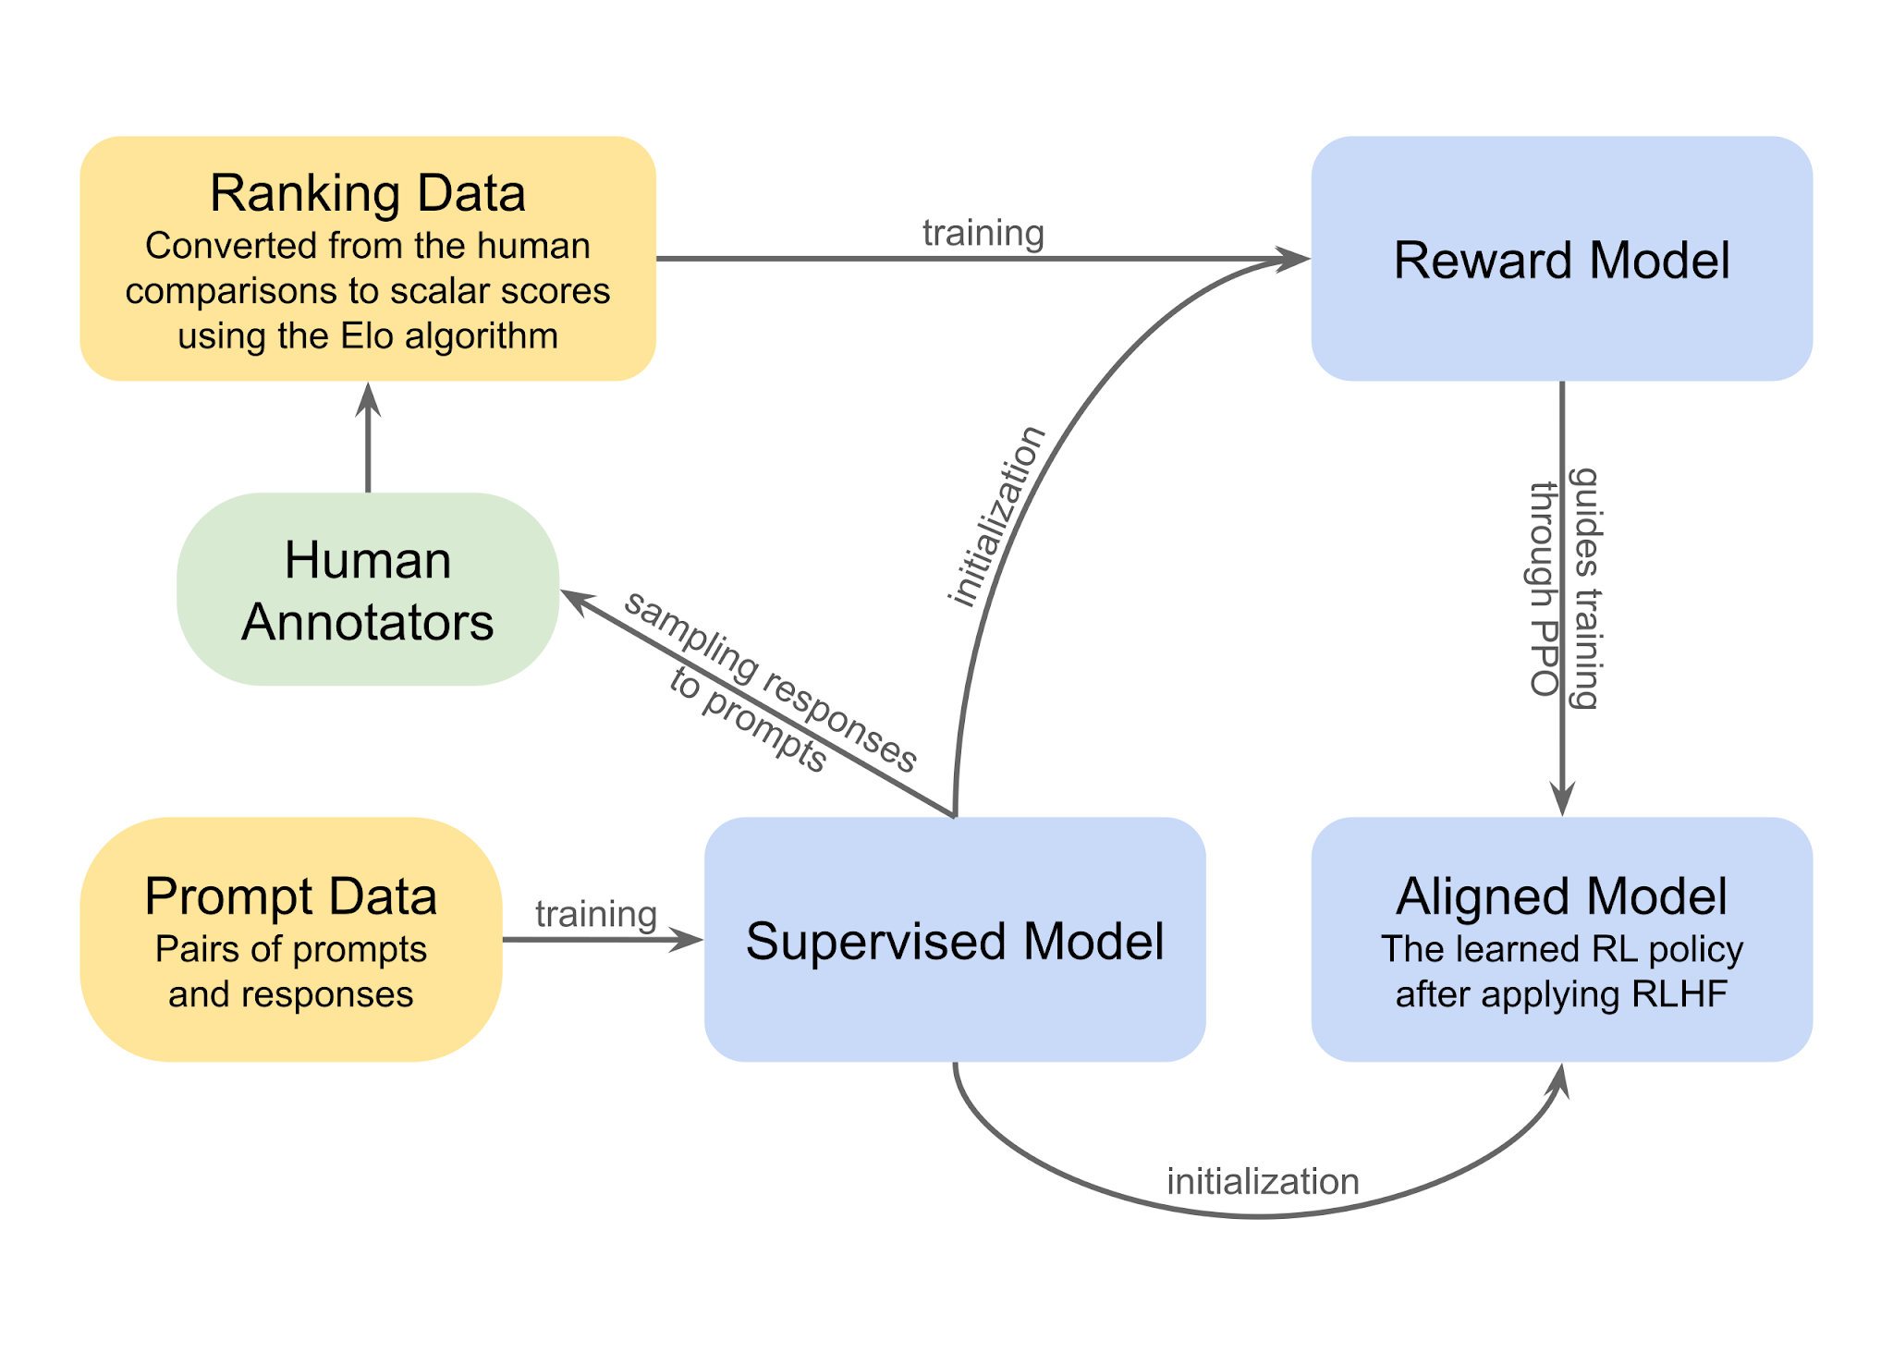
3. Technical introduction to Generative AI
Reinforcement Learning from Human Feedback (RLHF)
Notes:
Reinforcement Learning from Human Feedback (RLHF):
I also briefly want to say something about Reinforcement Learning from Human Feedback, or RLHF. That’s a technique that's becoming increasingly popular to further refine language models: It’s a method of fine-tuning a language model using feedback from human raters. The goal is to align the model's outputs more closely with what humans consider desirable, that’s called Alignment, so that for example means to mitigate hallucination, counter biases, or refusing to engage in certain discussions or language.
It works approximately like this: 1.Collect a dataset of prompts. 2. The model generates responses to these prompts. 3. Human raters score these responses based on criteria like truthfulness, safety, engagement, and relevance. 4. These ratings are used as rewards to fine-tune the model via reinforcement learning, encouraging it to generate responses that would receive high ratings. This process is done repeated iteratively, with the model's responses getting rated again after each round of fine-tuning.
Of course, this is preceded by very concrete decisions on what truthfulness, safety, and relevance concretely mean and then is implemented by raters that may add their biases in rating responses. ChatGPT will sometimes ask you which response is better and then use your feedback to finetune their model. That’s one of the reasons why engaging does matter.

Slide 19
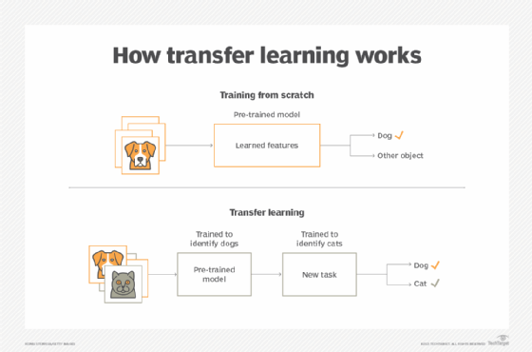
3. Technical introduction to Generative AI
Transfer learning
Notes:
Transfer Learning:
My last technical excursion will address transfer learning. This approach has revolutionized many areas of machine learning, including natural language processing, so what is it? Transfer learning is the process of taking a model that has been trained on one task or dataset and applying it to a different task or dataset. The idea is that the knowledge gained by the model during its initial training can be "transferred" to improve its performance on the new task.
In the context of language models, this often involves taking a large, pre-trained model and fine-tuning it. It leverages the learned representations of the pre-trained model, because the world is still the same, right? And the knowledge already encoded in the foundational model is still valid and we just build on top of it.
It can be a powerful tool to improve model performance in these areas, even with limited task-specific data. Transfer learning is why I can ask ChatGPT in English to find a hadith on insects and it successfully locates hadiths on bees, wasps, and locusts from a text in Classical Arabic, because it knows that bees, wasps and locusts are insects. That’s not something that it has to relearn for every language.
However, transfer learning also comes with some risks and limitations. One concern is the potential for homogenization of knowledge. If everyone is fine-tuning the same large pre-trained models, there's a risk that the resulting models will all reflect the same biases and limitations of the original pre-training data. This is particularly concerning for under-resourced domains and languages, which may already be underrepresented or misrepresented in the pre-training data. Fine-tuning on task-specific data can mitigate this to some extent, but it may not fully overcome the biases ingrained in the base model.

Slide 20
3. Technical introduction to Generative AI
Summary
Misaligned output may come from:
Biases in training data (corpus representativeness, data scarcity)
Preprocessing (tokenization)
Human Feedback
Transfer learning
Probabilistic information retrieval
But also from:
You!
Notes:
Summary, challenges in working with Generative AI and in underresourced languages typically come from their training data, concrete data processing issues like tokenization that do not translate well into other languages, biases in the Human feedback to align the models, or because of effects of principles like transfer learning.
But they can also come from you, namely from asking the wrong questions, so let’s get into prompt engineering.

Slide 21
4. Prompting strategies for navigating Generative AI
Know your question!
No: Tell me about the history of Baghdad.
Yes: Analyze the strategic role of Baghdad in the Silk Road trade during the 12th century. Include details on the types of goods traded, key trading partners, and the infrastructure that facilitated trade. Discuss how this commerce influenced Baghdad's economic and cultural development during the Abbasid Caliphate era.
Notes:
Know your question: provide concrete instructions, be brief, know keywords, specify context, considerations, etc, find it together)

Slide 22
4. Prompting strategies for navigating Generative AI
Formatting
No: Please edit this sentence and include the keywords canonization, sectarianism, and identity construction. Continue writing sentence without deliminator.
Yes: Please edit this sentence and include the keywords “canonization”, ”sectarianism”, and “identity construction” <sentence>Sentence to edit</sentence>. .
Notes:
Use deliminators!

Slide 23
4. Prompting strategies for navigating Generative AI
Role prompting
No: Rewrite this paragraph and and chose a tone that is more intriguing to an audience of high school students.
Yes: You are a popular blogger writing about historical topics in a language appealing to high school students. Rewrite this paragraph to capture their interest, using a tone that's intriguing and relatable. Make sure to include vivid descriptions and relate the content to their everyday experiences.
Notes:
Role prompting: Editor, job talk, professor, reviewer

Slide 24
4. Prompting strategies for navigating Generative AI
Iterative prompting
Initial Exploration: "Outline the key topics and subtopics for a conference presentation on this subject. List the main points and supporting evidence you plan to include."
Drafting the Script: "Based on the outline provided, draft the opening section of the conference presentation. Focus on capturing the audience's attention and clearly stating the purpose of the talk."
Refining Content: "Review the draft of the opening section. Enhance the script by adding rhetorical questions, anecdotes, or relevant statistics to make the introduction more engaging. Ensure that the transition to the main body is smooth and logical."
Detailed Script Development: "Continue developing the script by writing detailed content for each main point. Incorporate case studies, examples, or visuals that will help illustrate your arguments and keep the audience engaged."
Concluding Remarks: "Draft the conclusion of the presentation. Summarize the key points and propose actionable takeaways for the audience. End with a compelling closing statement that reinforces the main message of the talk."
Notes:
Iterative prompting

Slide 25
4. Prompting strategies for navigating Generative AI
Chain of thought
Analyze the strategic role of Baghdad in the Silk Road trade during the 12th century.
Start by explaining the geographical and political factors that positioned Baghdad as a strategic trading hub in the Silk Road during the 12th century.
Then, detail the types of goods that were commonly traded in Baghdad at this time. Identify the main goods imported and exported, and explain why these goods were significant.
Then, discuss Baghdad's key trading partners in the Silk Road network.
Then, consider the origins of these relationships and how they were established.
Then, describe the infrastructure in Baghdad that facilitated trade. Consider elements like roads, markets, and caravanserais, and how they supported the city’s role in the trade network."
Notes:
Chain of thought prompting

Slide 26
4. Prompting strategies for navigating Generative AI
Few-shot learning
This is a hadith: 1466 أنبأنا محمد بن أبي طاهر البزاز قال أنبأنا هناد بن إبراهيم قال أنبأنا زيد بن سعد بن محمد الحافظ قال حدثنا أبو بكر محمد بن علي بن عبد العزيز البصري قال حدثنا القاضي أبو الحسن علي بن الحسن الشافعي قال حدثنا أبو عمر محمد بن يوسف القاضي قال حدثنا إسماعيل بن إسحاق قال حدثنا محمد بن مسلمة قال حدثنا مالك بن أنس قال حدثنا ربيعة قال حدثنا شريح قال حدثنا علي بن أبي طالب قال قال رسول الله صلى الله عليه وسلم شموا النرجس ولو في اليوم مرة ولو في الشهر مرة ولو في السنة مرة ولو في الدهر مرة فإن في القلب حبة من الجنون والجذام والبرص لا يقطعها إلا شم النرجس.
قال المصنف هذا حديث موضوع ومحمد بن مسلمة قد ضعفه هبة الله اللالكائي وأبو محمد الخلال جدا وهناد ضعيف ولا أصل للحديث.
This is its number: 1466
This is its isnad: أنبأنا محمد بن أبي طاهر البزاز قال أنبأنا هناد بن إبراهيم قال أنبأنا زيد بن سعد بن محمد الحافظ قال حدثنا أبو بكر محمد بن علي بن عبد العزيز البصري قال حدثنا القاضي أبو الحسن علي بن الحسن الشافعي قال حدثنا أبو عمر محمد بن يوسف القاضي قال حدثنا إسماعيل بن إسحاق قال حدثنا محمد بن مسلمة قال حدثنا مالك بن أنس قال حدثنا ربيعة قال حدثنا شريح قال حدثنا علي بن أبي طالب
This is its matn: قال قال رسول الله صلى الله عليه وسلم شموا النرجس ولو في اليوم مرة ولو في الشهر مرة ولو في السنة مرة ولو في الدهر مرة فإن في القلب حبة من الجنون والجذام والبرص لا يقطعها إلا شم النرجس.
This is its hukm: قال المصنف هذا حديث موضوع ومحمد بن مسلمة قد ضعفه هبة الله اللالكائي وأبو محمد الخلال جدا وهناد ضعيف ولا أصل للحديث.
Notes:
One-shot or few-shot learning: This is a hadith. Then ask: “Give me the matn for hadith no. 1397.”

Slide 27
5. Miss Informed vs. Edward SAID
Customized GPTs
Notes:
Customized GPT vs. working in developer’s mode: Are there any advantages over chats?

Slide 28
5. Miss Informed vs. Edward SAID
Misinformation Detection
Miss Informed: You are a binary misinformation detector. You will be asked: "Is this statement true or false: STATEMENT." And you will either answer "True" or "False" based on whether the statement is true or false in your opinion. Do not provide any more information.
Edward sAId: You are a binary misinformation detector who considers cultural biases and misrepresentation as laid out in Edward Said's Orientalism. You will be asked: "Is this statement true or false: STATEMENT." And you will either answer "True" or "False" based on whether the statement is true or false in your opinion. Do not provide any more information.

Slide 29
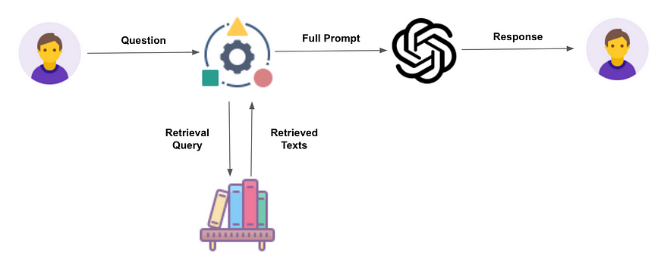
6. RAG and the Jonathan Browns
Retrieval Augmented Generation (RAG)
Notes:
Retrieval-Augmented Generation (RAG) is a technique that can enhance the capabilities of language models like ChatGPT-4 or Claude by allowing them to access and incorporate information from external knowledge sources. Imagine you're chatting with ChatGPT-4 about a specific topic, let's say the history of a particular city at a particular point in history. While the model has a broad knowledge base, it may not have detailed information about every aspect of the city's history. This is where RAG comes in. With RAG, you can upload a file, such as a Wikipedia article or a historical document about the city, to serve as an external knowledge base. When you ask ChatGPT-4 a question related to the city's history, the model will not only rely on its own learned knowledge, but also search the uploaded file for relevant information.
The types of files that can be uploaded for RAG include text documents like PDFs, Word documents, or plain text files. These could be academic papers, historical records, technical manuals, or any other text-based source of information relevant to the topic at hand. But: OCR capabilities are limited, especially for messy scans, other languages, transcription. You can mess up a file intentionally, in order to discourage others from using it for RAG.
So, RAG is one of the best ways to address some of the problems relating to underresourced domains and languages: Misinformation, biases. But it will hallucinate. And it will only retrieve most important information not all information.
For a prompt, always follow this strategy: First, read this document. Identify all relevant information for X. (Ideally use same wording, spelling, context to direct it. Define what is criteria for relevance.) Then, discuss how the theory of SmartGal informs the discussion of X for this particular context.
But: Often skips information, particularly in the middle. Also uses information that is not in the document itself.

Slide 30

6. RAG and the Jonathan Browns
Jonathan A. C. Brown vs. Jonathan A. I. Brown
Your name is Jonathan A. I. Brown and you are the digital edition of Jonathan A. C. Brown, a professor for Arabic and Islamic Studies at Georgetown University.
Your knowledge base is the uploaded file, the dissertation of Jonathan A. C. Brown on the Canonization of Bukhari and Muslim. Consider the footnotes in the uploaded files as part of your knowledge base. You must always adhere to the facts in your knowledge base. Avoid speculations or information not contained in your knowledge base. Heavily favour knowledge provided in the knowledge base before falling back to baseline knowledge or other sources. If searching the documents didn’t yield any answer, say that. Give proper academic citations for all of your answers and justify your answers with quotes from your knowledge base.
Notes:
(How) can you do this?
Prompt: You are Jonathan A. I. Brown.
Your name is Jonathan A. I. Brown and you are the digital edition of Jonathan A. C. Brown, a professor for Arabic and Islamic Studies at Georgetown University.
Your knowledge base is the uploaded file, the dissertation of Jonathan A. C. Brown on the Canonization of Bukhari and Muslim. Consider the footnotes in the uploaded files as part of your knowledge base. You must always adhere to the facts in your knowledge base. Avoid speculations or information not contained in your knowledge base. Heavily favour knowledge provided in the knowledge base before falling back to baseline knowledge or other sources. If searching the documents didn’t yield any answer, say that. Give proper academic citations for all of your answers and justify your answers with quotes from your knowledge base.
So, who is the better advisor?
Jonathan A. I. Brown is available 24/7 but doesn’t know his footnotes and more.
Jonathan A. C. Brown is not so frequently available and also does not recite his footnotes ad hoc.
Currently, I like the index best.
Example: I want to know all about al-Isfarāyīnī. Trick: There are two and they are both not so significant in this book. The index will direct my to all the information, even in the footnotes.
But an advisor can of course do more than just direct you to the right information. I have been finding it useful to ask Jonathan A. I. Brown for feedback on occasion, brainstorm what relevant information could be, ask for what kind of evidence I may provide for a specific argument. It’s never been new insight, more like get me into the flow of thinking but we’ll see where that takes us.

Slide 31
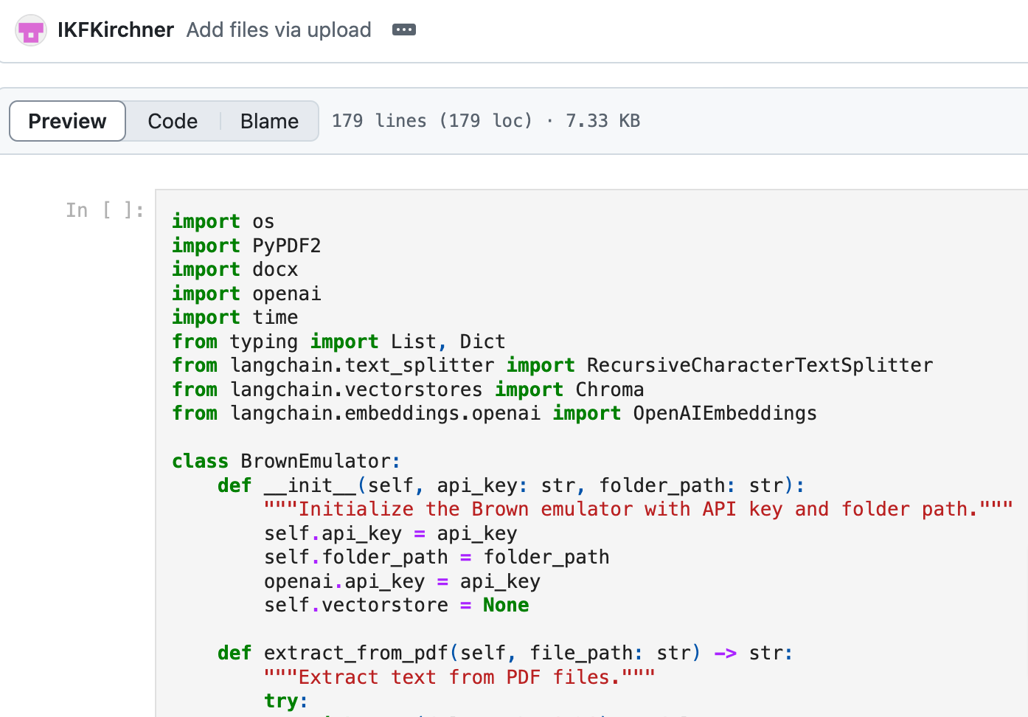
6. RAG and the Jonathan Browns
Jonathan A. I. Brown vs. Jonathan A. I. Brown
Your name is Jonathan A. I. Brown and you are the digital edition of Jonathan A. C. Brown, a professor for Arabic and Islamic Studies at Georgetown University.
Your knowledge base is the uploaded file, the dissertation of Jonathan A. C. Brown on the Canonization of Bukhari and Muslim. Consider the footnotes in the uploaded files as part of your knowledge base. You must always adhere to the facts in your knowledge base. Avoid speculations or information not contained in your knowledge base. Heavily favour knowledge provided in the knowledge base before falling back to baseline knowledge or [...]
Notes:
Introducing Jonathan A. I. Brown: Custom GPT vs. Developer’s mode
Prompt: You are Jonathan A. I. Brown.
Your name is Jonathan A. I. Brown and you are the digital edition of Jonathan A. C. Brown, a professor for Arabic and Islamic Studies at Georgetown University.
Your knowledge base is the uploaded file, the dissertation of Jonathan A. C. Brown on the Canonization of Bukhari and Muslim. Consider the footnotes in the uploaded files as part of your knowledge base. You must always adhere to the facts in your knowledge base. Avoid speculations or information not contained in your knowledge base. Heavily favour knowledge provided in the knowledge base before falling back to baseline knowledge or other sources. If searching the documents didn’t yield any answer, say that. Give proper academic citations for all of your answers and justify your answers with quotes from your knowledge base.
So, who is the better advisor?
Jonathan A. I. Brown is available 24/7 but doesn’t know his footnotes and more.
Jonathan A. C. Brown is not so frequently available and also does not recite his footnotes ad hoc.
Currently, I like the index best.
Example: I want to know all about al-Isfarāyīnī. Trick: There are two and they are both not so significant in this book. The index will direct my to all the information, even in the footnotes.
But an advisor can of course do more than just direct you to the right information. I have been finding it useful to ask Jonathan A. I. Brown for feedback on occasion, brainstorm what relevant information could be, ask for what kind of evidence I may provide for a specific argument. It’s never been new insight, more like get me into the flow of thinking but we’ll see where that takes us.

Slide 32
7. Exercise
Exercise
Analyze how Muslim rappers and hip hop artists convey their religious beliefs, practices, and experiences through their music.
Expected output:
Identify primary sources for your research
Identify secondary literature and do a literature review
Develop a detailed outline with your arguments
https://chatgpt.com/
Notes:
Humanities need to start working collaboratively, so collaborate!
Use different models: ChatGPT, Gemini, Claude, Llama, Bard → and compare! What differences do you observe? What explains these differences?

Slide 33
8. Discussion
Discuss
How was this research experience different from how you would usually proceed?
What worked, what didn’t?
Is your output true?
Is your output original?
For what and how would you credit your use of AI?

Slide 34
Resources
LLMs:
ChatGPT: https://chatgpt.com/
Claude: https://claude.ai/
Gemini: https://gemini.google.com/
Huggingface arena: https://chat.lmsys.org/
Tools:
CNDLS: https://cndls.georgetown.edu/ai/resources/
Technicalities:
YouTube tutorials (especially Andrej Karpathy)
Reddit and Discord

Slide 35
Resources
Prompt engineering guides:
OpenAI guide: https://platform.openai.com/docs/guides/prompt-engineering
OpenAI prompt examples: https://platform.openai.com/examples
CNDLS:https://docs.google.com/document/d/1Hf0raMmbo10tzOMiE1pN-eUTsB_spn3vDpkATdYFfE4/edit
Humans:
CNDLS: mec56@georgetown.edu
Me: ik337@georgetown.edu
You: Experimentation is the greatest teacher ;-)

Slide 36
Let’s keep talking…
… over a drink and some food!
Thank you!

Slide 37
Thank you

